Slide 1
Text-to-Speech (TTS) Guide for TestNav
Updated fall 2020

Slide 2
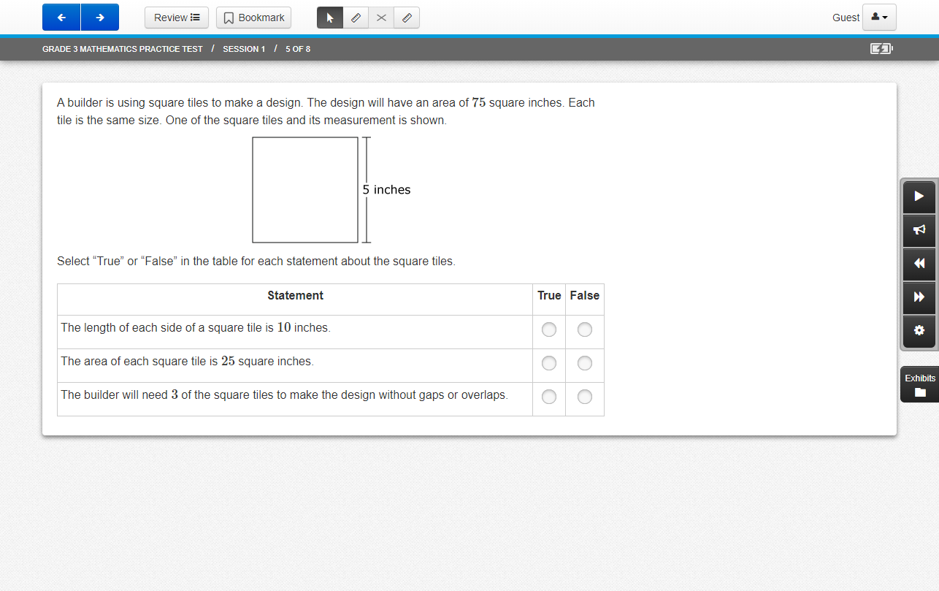
The text-to-speech (TTS) controls are located on the right-hand side of the screen.

Slide 3
Click the Play button to start the TTS voice at the beginning of the item text.

Slide 4
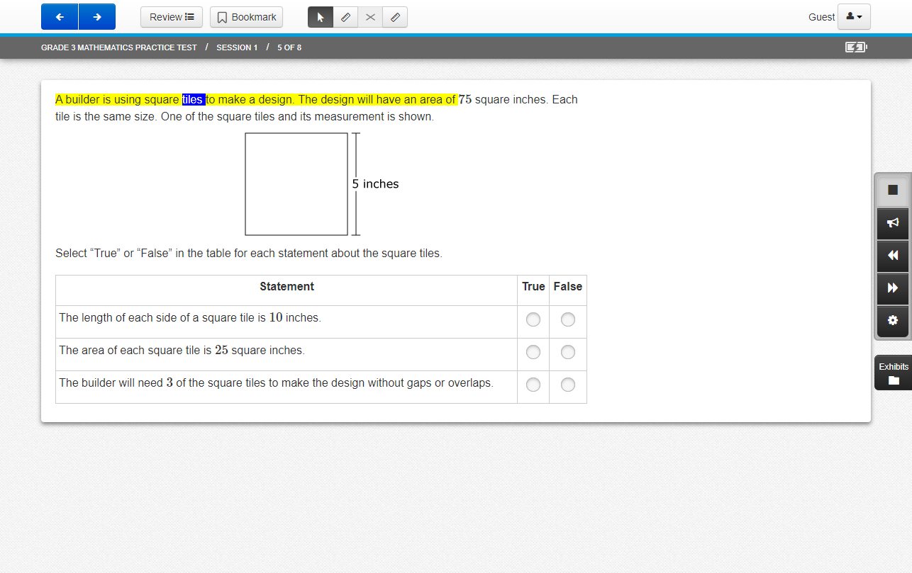
Once the Play button is selected the icon changes to the Stop button.
A student can stop the TTS voice at any time, or the TTS Voice will continue to read aloud the entire item text.
The Stop button changes back to the Play button when the TTS voice has stopped.

Slide 5
The section of text that is being read aloud will be highlighted in yellow and the individual word being read aloud will be highlighted in blue.

Slide 6
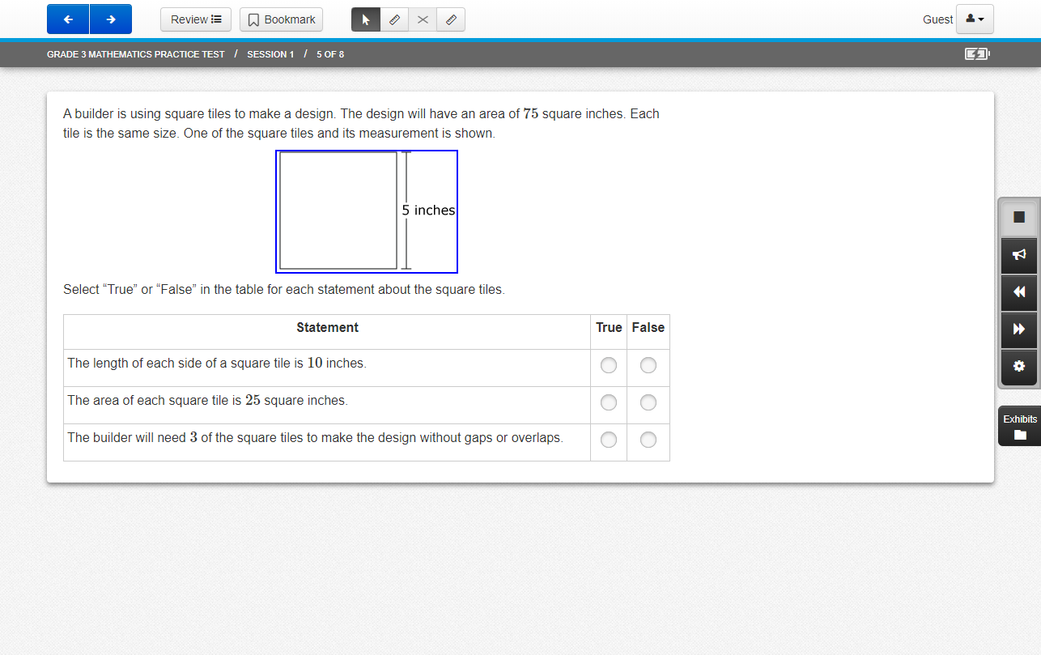
When the text in a graphic, table, or graph is read aloud, no text will be highlighted.
Instead, a blue outline will appear around the graphic image.

Slide 7
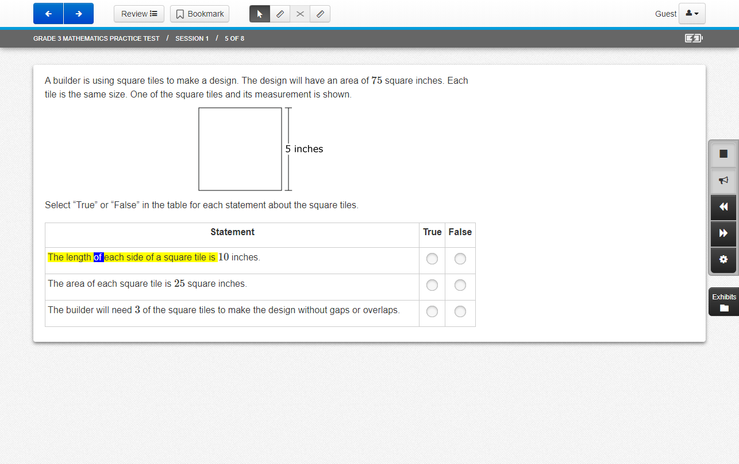
Click the Click-to-Hear button to select where the read-aloud will begin.
The student uses this button to click on the desired section of the text to be read aloud.

Slide 8
Click the Jump Back or Skip Ahead button to skip to other portions of text. TTS will continue to read following the selected portion that the student moved to.

Slide 9
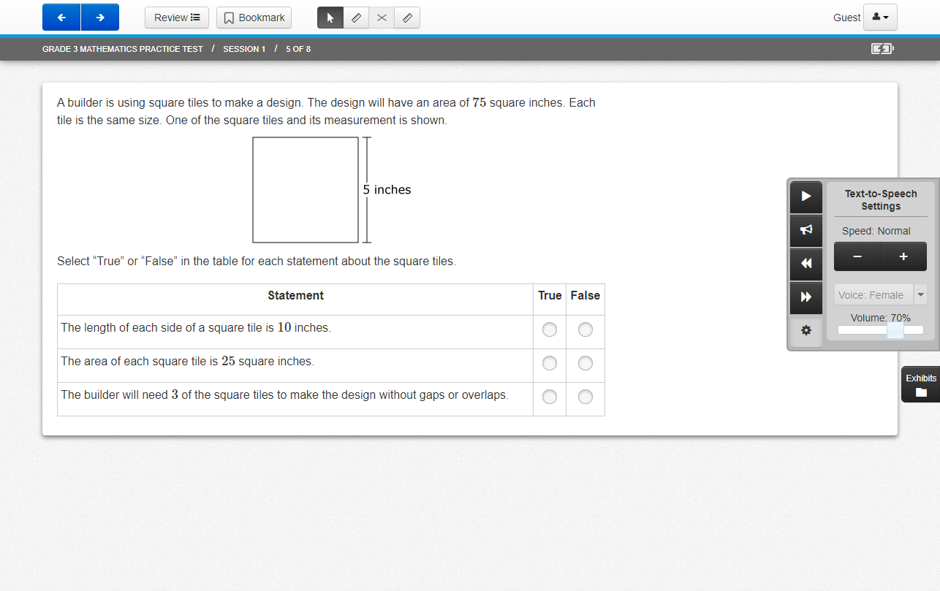
Click the Settings button to expand a panel that allows a student to control the speed of the TTS voice.
A student can click the minus ( ̶ ) or plus (+) sign to change the speed of the TTS voice to Slow, Normal, or Fast.
Only the female voice is available for testing.

Slide 10
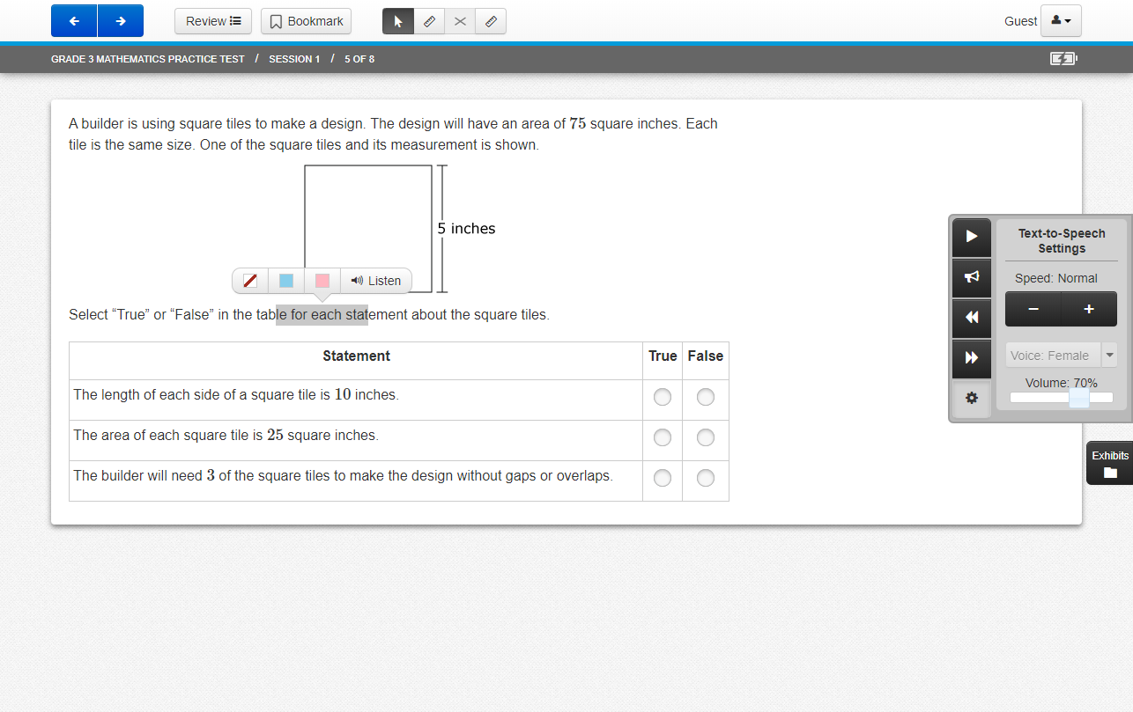
The Listen-to-Hear feature will allow text that is highlighted by the student to be read aloud. Clicking the “Listen” button activates TTS to read aloud the sentence that is highlighted.
TTS will not automatically continue reading using this feature and will stop playing at the end of this sentence.

